Slide 1
Teknologi Open Source Overview of Open Source Lecture 01 (16 Feb 2015)
Henry Novianus Palit
hnpalit@petra.ac.id

Slide 2
History (1)
Software-sharing community existed for many years
In 1950s and 1960s almost all software was produced by computer science academics and corporate researchers working in collaboration
Source code was generally distributed with the software itself because users frequently modified the software themselves due to different hardware or OS, and to fix bugs or add new functionality
Similarly, researchers with access to ARPANET used a process called Request for Comments to develop telecommunication network protocols; this collaborative process led to the birth of the Internet in 1969

Slide 3

History (2)
Decline of free software
By the late 1960s, software production costs were dramatically increasing as the software industry was competing with the hardware manufacturers’ bundled software products
In early 1970s, AT&T distributed early versions of UNIX at no cost to government and academic researchers, but restricted them to redistribute or to distribute modified versions; after UNIX became more widespread in early 1980s, AT&T stopped the free distribution and charged for system patches, so most researchers had to pay for a commercial license

Slide 4
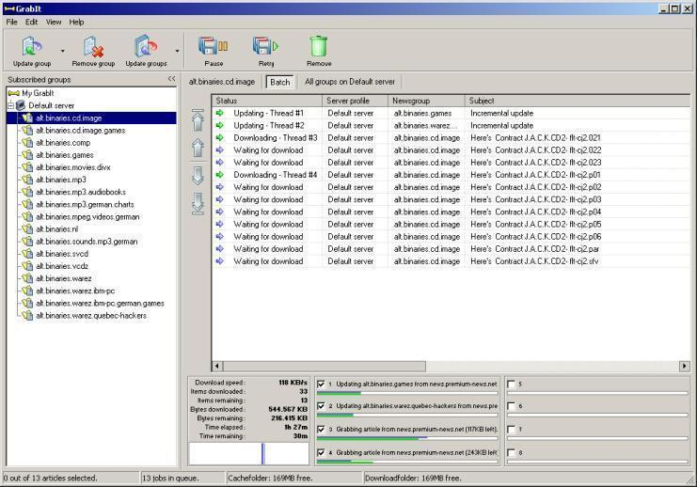
History (3)
Online software sharing communities in 1980s
In the 1980s, software with source code was shared on BBS networks; it was sometimes a necessity for software written in BASIC and other interpreted languages
The advent of Usenet and UUCPNet in the early 1980s further connected the programming community and provided a simpler way for programmers to share their software and contribute to software others had written

Slide 5
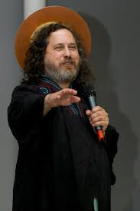
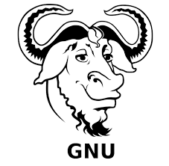
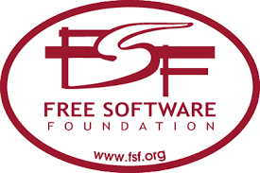
History (4)
Free Software Foundation
In 1983, Richard Stallman started the GNU Project to build an OS free from constraints on use of its source code
Stallman coined the term “Free Software” and founded FSF in 1985
The first version of GNU General Public License (GPL) was published in 1989
GNU project’s kernel, called GNU Hurd, was continually delayed, but most components were completed by 1991

Slide 6

History (5)
Linux
In 1980s to early 1990s, UNIX was too expensive for private users, GNU Hurd failed to attract enough development effort, 386BSD (Berkeley Software Distribution) faced a lawsuit from AT&T
MINIX, a UNIX-like system intended for academic use, was released by Andrew S. Tanenbaum in 1987
In 1991, Linus Torvalds began a project developing a kernel using MINIX and GNU CC; it was published as “Linux” by his co-worker

Slide 7

History (6)
Linux (cont’d)
Initially Torvalds published the kernel under its own license, which restricted commercial activity
The software to use with the kernel was part of the GNU project, licensed under GPL
In February 1992, with the release of version 0.12, Torvalds relicensed the project under the GNU GPL
Combination of the almost-finished GNU OS and the Linux kernel made the first complete free-software OS

Slide 8




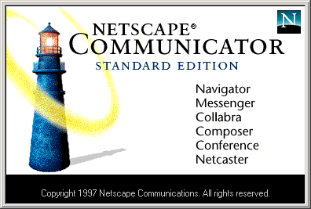
History (7)
Other free software
After settling the lawsuit in 1993, FreeBSD and NetBSD were released as free software; OpenBSD forked from NetBSD in 1995
Apache HTTP Server was released under the Apache License 1.0 in 1995
Netscape Communicator Internet suite (better known today as Mozilla Firefox and Thunderbird) was released as free software under Netscape Public License in 1998

Slide 9
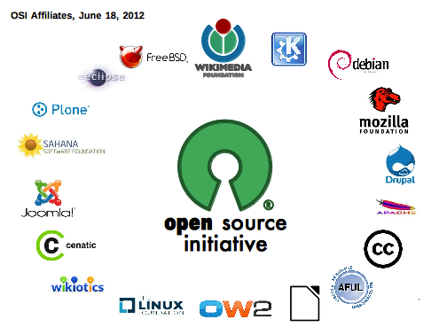
History (8)
Open Source Initiative
Netscape’s act prompted Eric Raymond and others to look into how to bring the free software ideas and perceived benefits to the commercial software industry
A new term – “open source” – was chosen, and was quickly supported by Bruce Perens, Tim O’Reilly, Linus Torvalds, Guido van Rossum & others
Open Source Initiative was founded in 1998 to encourage use of the new term and evangelize open-source principles

Slide 10
History (9)
In 1998, a part of the free software community splintered off and began campaigning in the name of “open source.” The term was originally proposed to avoid a possible misunderstanding of the term “free software,” but it soon became associated with philosophical views quite different from those of the free software movement.

Slide 11
Free Software Definition
Free software is defined as software that ensures that the end users have freedom in using, studying, sharing, and modifying that software
The term “free” is used in the sense of “free speech”, not of “free of charge”
The four freedoms:
Freedom to run the program as you wish, for any purpose
Freedom to study how the program works, and change it so it does your computing as you wish
Freedom to redistribute copies so you can help your neighbor
Freedom to distribute copies of your modified versions to others
(Source: http://www.gnu.org/philosophy/free-sw.html)

Slide 12
Open Source Definition (v 1.9) (1)
Free redistribution → license shall not require a royalty or other fee for such sale
Source code → program must include source code
Derived works → license must allow modifications and derived works distributed under the same terms
Integrity of the author’s source code → license may restrict source-code being distributed in modified form only if it allows the distribution of “patch files” with the source code
No discrimination against persons or groups
Source: http://www.opensource.org/docs/osd

Slide 13
Open Source Definition (v 1.9) (2)
No discrimination against fields of endeavor → license must not restrict anyone from making use of the program in a specific field of endeavor. For example, it may not restrict the program from being used in a business, or from being used for genetic research.
Distribution of license → no need for execution of an additional license (e.g., a non-disclosure agreement)
License must not be specific to a product → must not depend on the program’s being part of a particular software distribution
License must not restrict other software
License must be technology-neutral
Source: http://www.opensource.org/docs/osd

Slide 14
Popular Licenses
Apache License 2.0
BSD 3-Clause “New” or “Revised” license
BSD 2-Clause “Simplified” or “FreeBSD” license
GNU General Public License (GPL)
GNU Library or “Lesser” General Public License (LGPL)
MIT license
Mozilla Public License 2.0
Common Development and Distribution License
Eclipse Public License

Slide 15
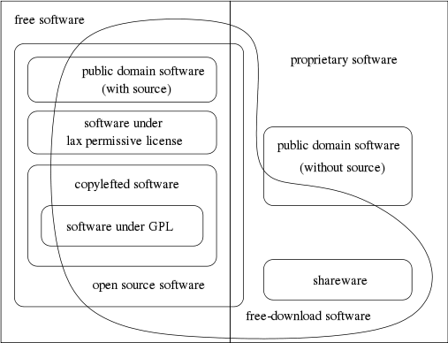
FOSS
Free and Open-Source Software
The differences in extension of the category are small: nearly all free software is open source, and nearly all open source software is free
(source: https://www.gnu.org/philosophy/categories.html)

Slide 16
Free : Freedom or Gratis?
Free software is software that comes with permission for anyone to use, copy, and/or distribute, either verbatim or with modifications, either gratis or for a fee. In particular, this means that source code must be available.
Free (in open source term) software is a matter of freedom, not price
In English; there is a word “gratis” that refers unambiguously to price, but no common adjective that refers unambiguously to freedom
So, for open source, it’s a free (freedom) software, either gratis or paid.

Slide 17
Reasons to Use GNU/Linux
Scalability – vertical and horizontal
Availability – failover extensions
Reliability – running dedicated applications well
Security – due to open source
Manageability – rich Linux management tools / frameworks / schema
Flexibility – running on various systems and devices (e.g., ARM, Saturn, Hitachi’s H8, HP’s Alpha, Sun’s UltraSparc, Intel’s Pentium, IBM’s PowerPC, etc.)
Server Consolidation – leveraging virtualization
Source: ftp://ftp.software.ibm.com/linux/pdfs/linux-ready.pdf

Slide 18
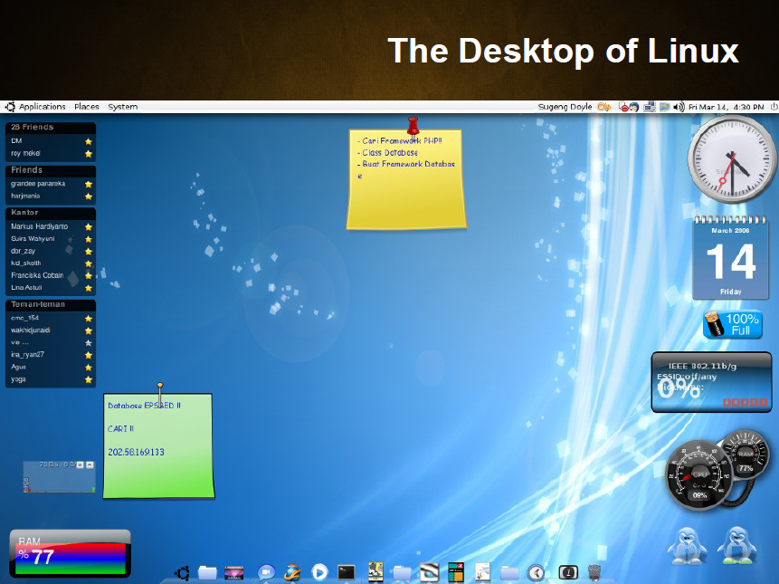

Slide 19
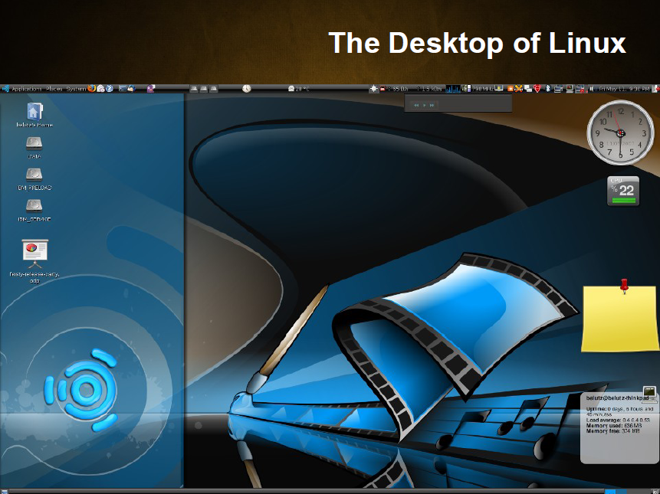

Slide 20
Desktop Applications
Word processing (OpenOffice)
Programming (C, C++, Perl, Java, PHP, Python)
Graphics (Gimp)
Web browser (Firefox)
Email (Evolution, KMail)
Audio (Amarok, MPlayer)
Games (OpenArena)

Slide 21
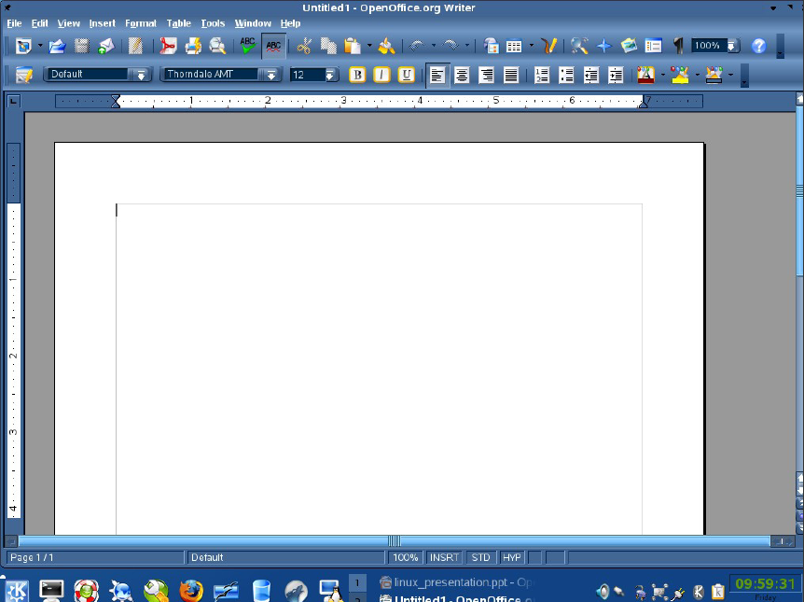

Slide 22
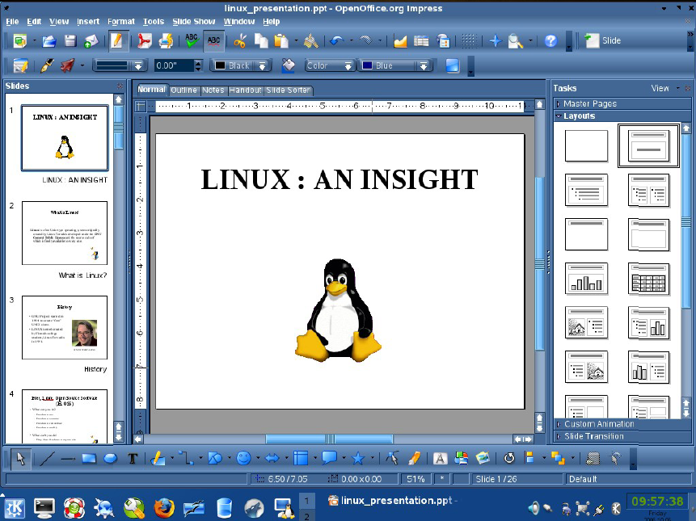

Slide 23
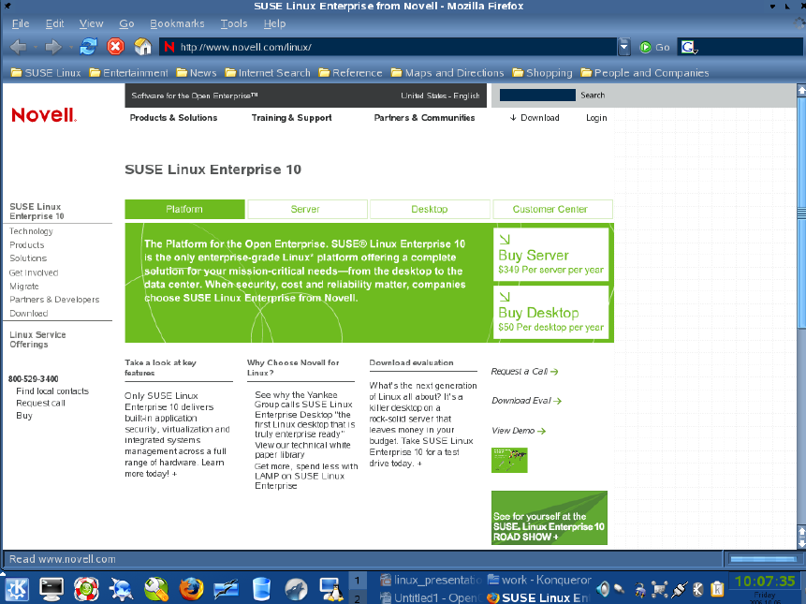

Slide 24
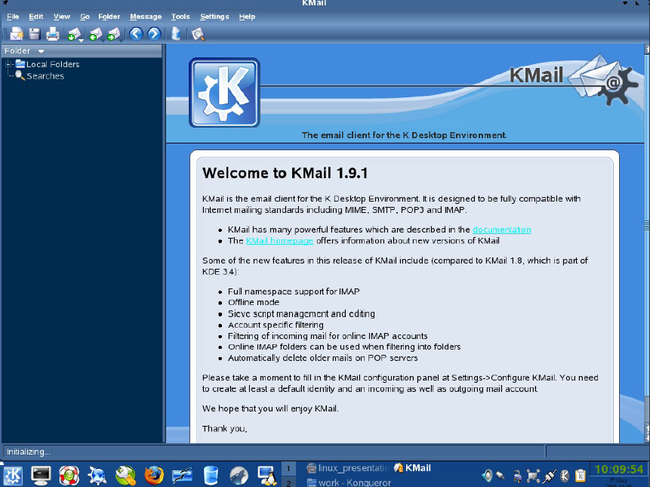

Slide 25
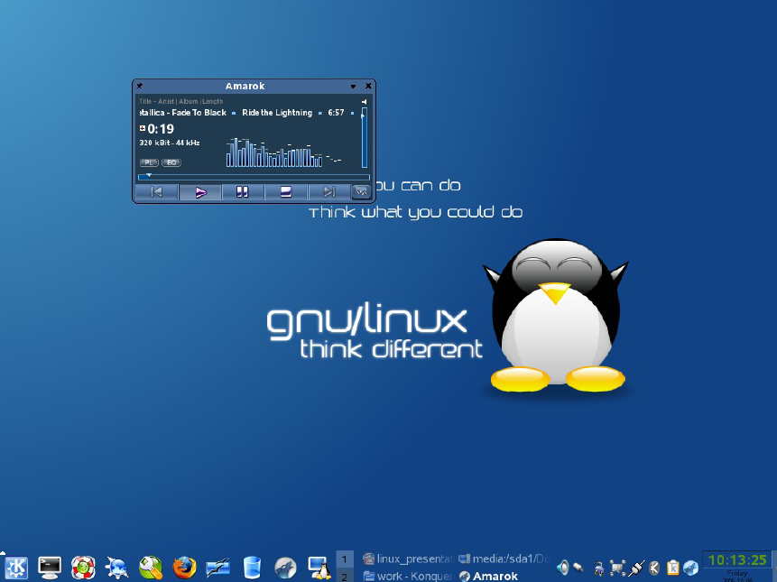

Slide 26
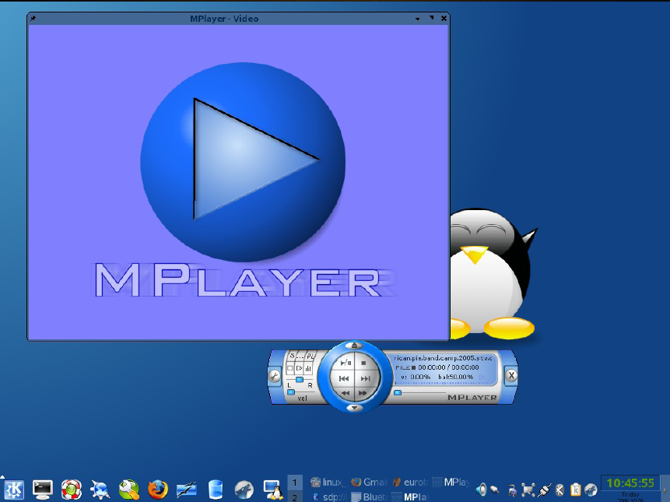

Slide 27
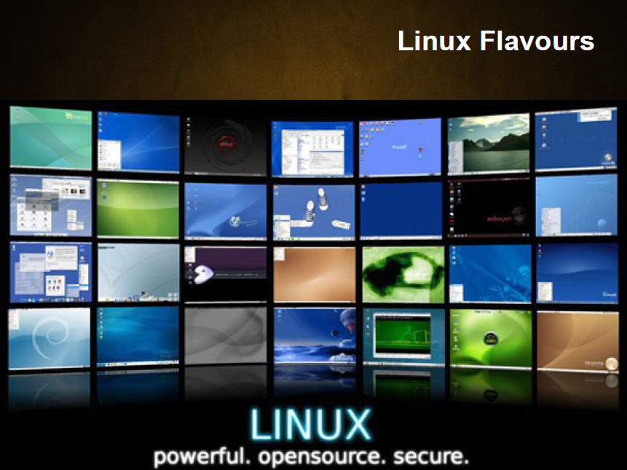

Slide 28
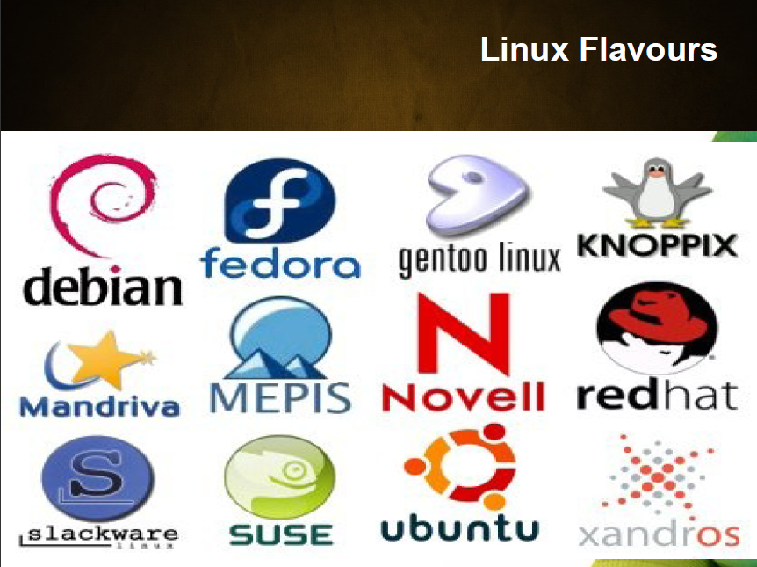

Slide 29
Open Source OSes
*
GNU/Linux
FreeBSD
OpenBSD
NetBSD
OpenSolaris
Minix
FreeDOS
etc.
Each has hardware based specification (32/64 bit)

Slide 30
Open Source Development
*
PHP
MySQL
C/C++
Perl
Tcl/Tk
Qt
Python (http://www.python.org)
Ruby (http://www.ruby-lang.org)
Java (http://openjdk.java.net)

